Slide 1

People's Advanced Reasoning Models and Compute

Slide 2

1 Innovations in AI Reasoning and Extended Thinking Capabilities

Slide 3

Claude's extended thinking for complex problem-solving
Theme: Advanced AI Reasoning
This theme focuses on the cutting-edge advancements in AI reasoning models, including Claude's innovative approaches.

Slide 4




OpenAI o-series advancements in reasoning architectures
Standard Performance Metrics
OpenAI o-series Architectural Insights
Theme: AI Compute Innovations
Normal performance metrics for the OpenAI o-series, providing a baseline for evaluating its reasoning and computational efficiency.
Delving into the architectural advancements of OpenAI's o-series, specifically designed to enhance reasoning capabilities.
This theme explores innovations in AI compute, with a focus on how the OpenAI o-series pushes boundaries.

Slide 5

DeepSeek R1's novel approach to computational reasoning
01
Typical Operational Standards
Typical operational standards for DeepSeek R1, ensuring reliability and predictability in its computational reasoning processes.
02
Catalogue: AI Reasoning Breakthroughs
Included in the catalogue on innovations in AI reasoning and extended thinking capabilities, featuring DeepSeek R1's breakthroughs.

Slide 6

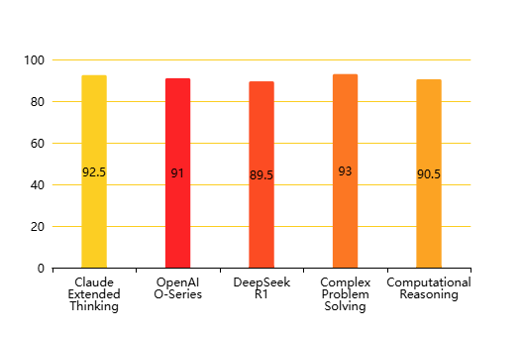
Advancements in Reasoning Models and Test-Time Compute
Impact of Advanced Reasoning Architectures(Effectiveness Score (%))

Slide 7
2 Optimizing Test-Time Compute for Enhanced Model Performance

Slide 8

Efficient compute utilization in advanced reasoning models
Advanced reasoning and compute
Optimizing compute for reasoning models
The theme of advanced reasoning models and their associated compute requirements highlights the critical interplay between model complexity and computational resources.
Advanced reasoning models like Claude extended thinking and DeepSeek R1 necessitate efficient compute utilization for optimal performance and cost-effectiveness.
20xx
20xxx
20xx
20xx
Normal compute operations
Optimizing test-time compute
Standard computational operations are fundamental to the execution of these sophisticated AI models, ensuring their basic functionality and processing capabilities.
Efficient compute utilization is a cornerstone of optimizing test-time compute for enhanced model performance, directly impacting inference speed and resource consumption.

Slide 9



Minimizing latency for real-time AI inference tasks
63%
75%
87%
Reducing latency in AI inference
Typical latency considerations
Real-time compute for AI
Minimizing latency is crucial for real-time AI inference tasks, especially with models like OpenAI o-series, to ensure prompt and responsive decision-making.
Typical latency considerations involve assessing network delays and processing times to ensure smooth operation of AI inference systems in various environments.
The theme emphasizes the importance of real-time compute for advanced reasoning models, directly addressing the need for low-latency inference in practical applications.

Slide 10

Scaling computational resources for complex AI workloads
Compute scaling for reasoning
Standard resource scaling
The theme underscores the necessity of scaling compute for advanced reasoning models, reflecting the increasing complexity and data intensity of modern AI applications.
Standard resource scaling involves adjusting computational capacity to meet varying demands, ensuring consistent performance for AI workloads without over-provisioning.
Scaling compute for AI workloads
Optimizing compute for scaling
Scaling computational resources is essential for handling complex AI workloads, particularly for advanced reasoning models that demand significant processing power.
Scaling computational resources is integral to optimizing test-time compute for enhanced model performance, facilitating the deployment of complex AI systems efficiently.

Slide 11
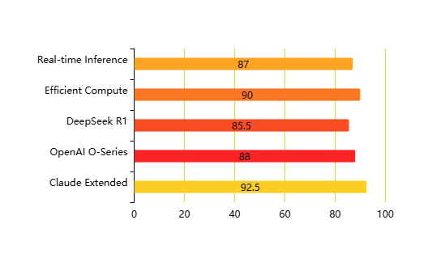
Advanced Reasoning Model Compute Utilization
Compute Utilization & Performance Metrics(Utilization (%))

Slide 12
THANK YOU

